Slide 1

Flutter
Build beautiful native apps in record time

Slide 2
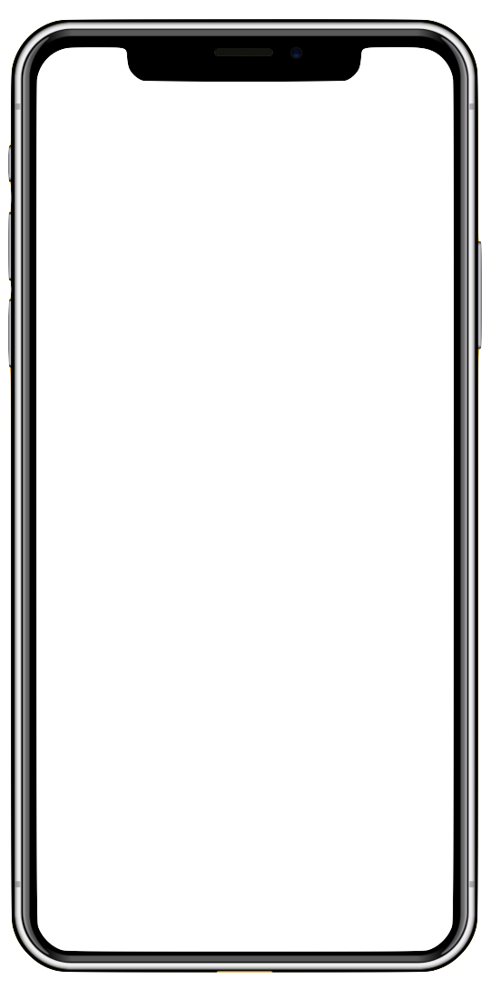
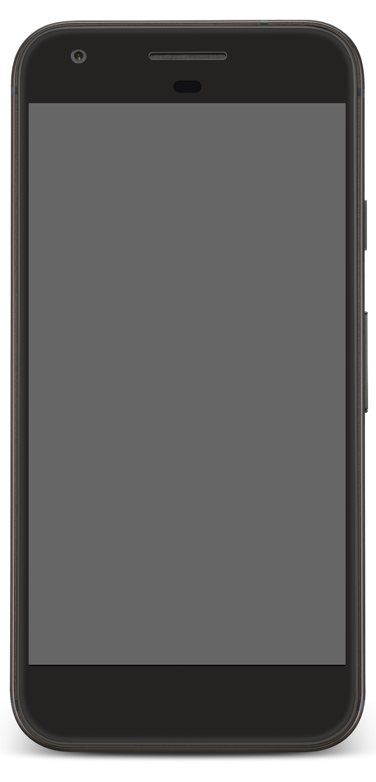
Flutter is Google’s UI Framework
Helping developers craft highquality native experiences across multiple platforms in record time.

Slide 3


Challenges of mobile development today
“To the metal” approaches
“Cross platform” approaches
High-quality apps
Platform and system integrations
Fast development
Quick iterations, hot reload
High-performance UIs
Native code, GPU accelerated
Portability, reach
Single codebase
Must fund two apps
Two teams, codebases, & investments
Poor Performance
Slow, jerky, unpredictable
Inconsistent brand, features
Different across devices & OEMs
Non-Native Look/Feel
Users can tell the difference

Slide 4
Flutter offers the best of both worlds
Flutter combines
native performance and quality with high-velocity development and multi-platform reach.
“
”

Slide 5
Flutter is a modern UI toolkit for native apps
iOS host
AppDelegate
Material
Cupertino
FlutterMethodChannel
FlutterViewController
Framework
(Dart)
Widgets
Flutter app (client)
Rendering
iOS
Platform
APIs
3rd-Party
APIs for iOS
MethodChannel
Animation
Painting
Gestures
State
Android host
Foundation
Activity
FlutterView
Engine
(C++)
Skia
Dart
Text
MethodChannel
Android
Platform
APIs
3rd-Party
APIs for Android
Notes:
Main points:
Flutter technology is an engine (light blue) and framework (dark blue).
The framework was designed to be accessible to, and customizable by, the developer. This gives developers control over their UI and pixels.
Flutter was made to be embeddable and portable.
Flutter runs in Android and iOS via native code and native integrations
Flutter connects to existing platform APIs and exposes them to the developer
Flutter is a component/library of a traditional APK/IPA

Slide 6




High-Velocity Development
Expressive and Flexible Toolkit
Native iOS and Android App

Slide 7

High-velocity development
Sub-second reload times
Paint your app to life
Iterate rapidly on features
Test hypotheses quicker than ever
More time to experiment & test features
Single-codebase for faster collab
3X Productivity Gains

Slide 8
Flexibility and Control for beautiful UI’s
Control every pixel on the screen
Make your brand come to life
Never say "no" to your designer
Stand out in the marketplace
Win awards with beautiful UI

Slide 9
Natively- Apps for iOS and Android
Compiles directly to native ARM code Does not use a JavaScript bridge
60fps, GPU accelerated
Smooth animations
Deep platform integrations
Natural look and feel
Critical platform differences (scrolling, navigation, fonts)
Canvas
App
Render
Events
Compiles to ARM native code,
GPU accelerated graphics
Notes:
There are three aspects to native:
Performance
Integrations
Feel and "muscle memory"
Flutter delivers on all three aspects.

Slide 10

Built and used by Google, developers and companies around the world
Notes:
Some examples of agencies and companies that are currently building apps, or have built apps, with Flutter.

Slide 11
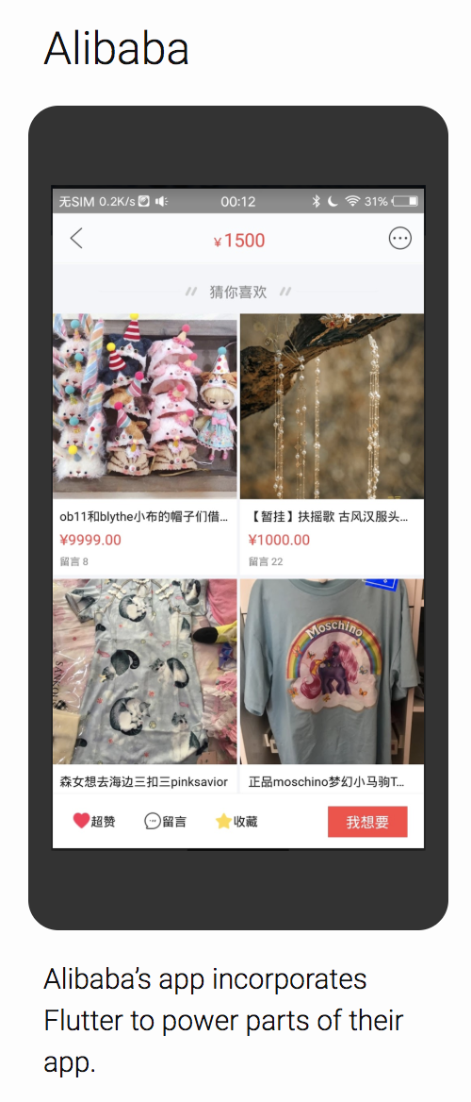
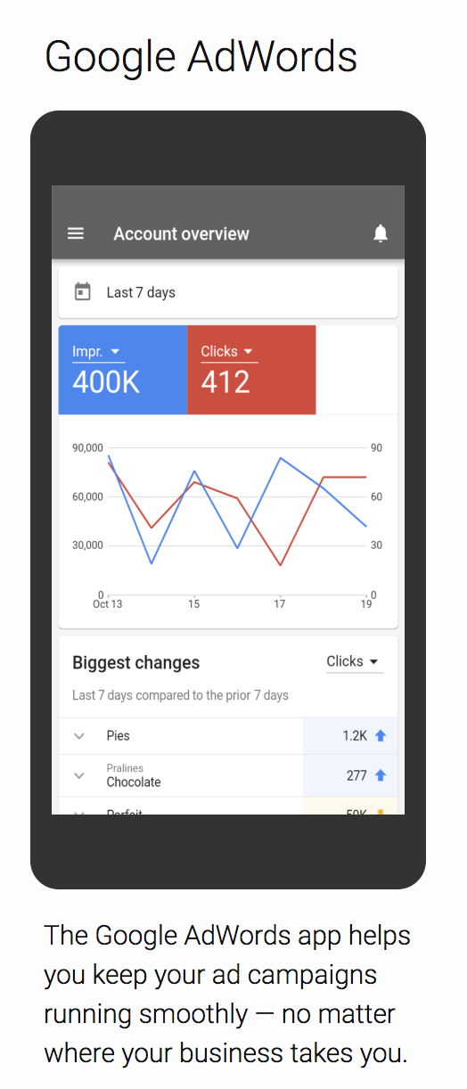
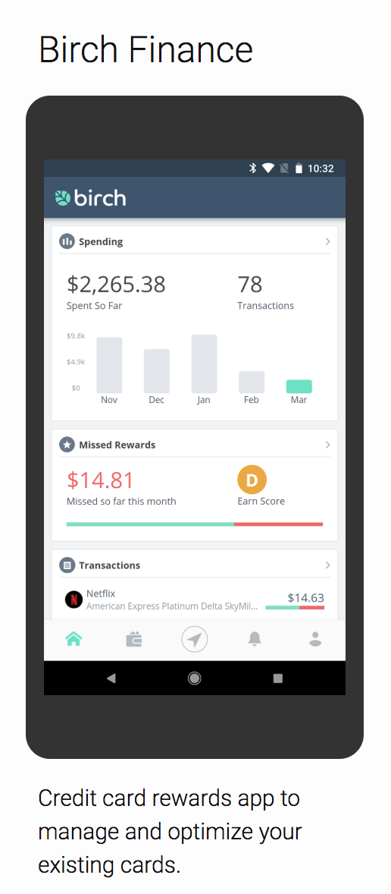
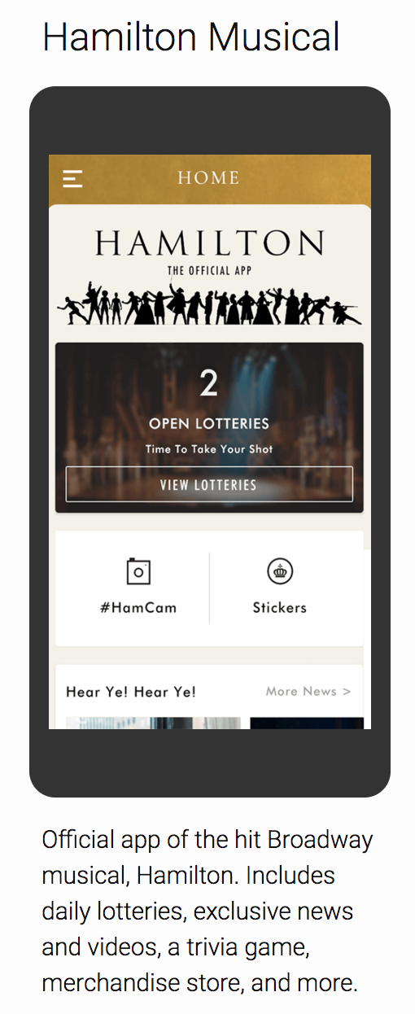

Slide 12
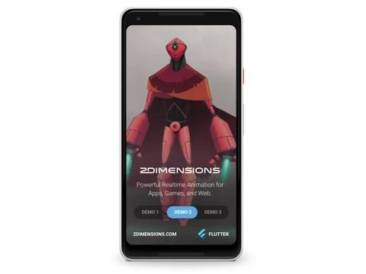
Graphic Horsepower
Flutter seamlessly combines user interface widgets with 60fps animated graphics generated in real time, with the same code running on iOS and Android
Notes:
What you are seeing here is Flutter rendering 2D skeletal mesh animations on the phone in real-time. Achieving this level of graphical horsepower is thanks to Flutter's use of the hardware-accelerated Skia engine that draws every pixel to the screen, paired with the blazingly fast ahead-of-time compiled Dart language. But it gets better: note how the demo slider widget is translucently overlaid on the animation. Flutter seamlessly combines user interface widgets with 60fps animated graphics generated in real time, with the same code running on iOS and Android.

Slide 13
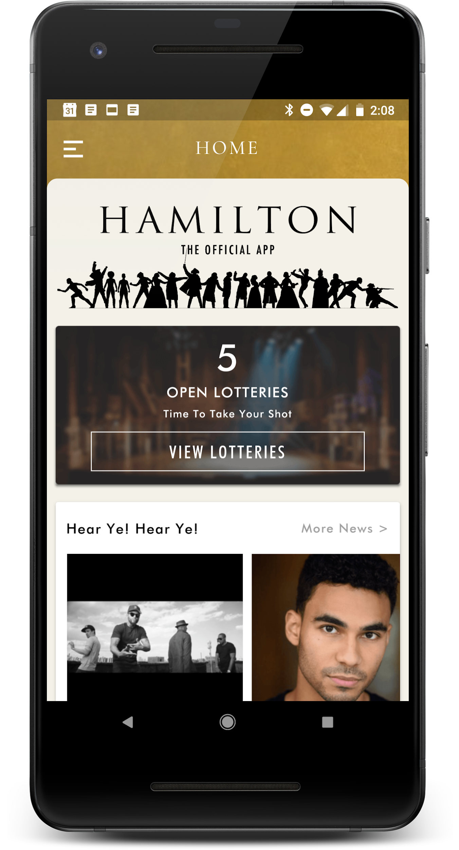
Hamilton launched as a featured app on iOS and Android within three months of us writing our first line of Flutter code.
David DeRemer Co-Founder, Posse
“
”
Notes:
Results: Launched in record time. 1M+ installs, 450k+ MAU, 160k + DAU, 65M+ Cloud Functions invoked, 4.7 Star rating on Google Play

Slide 14

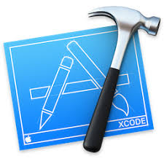






Works with popular tools and platforms
3rd-party
Android SDKs
Android Studio
Xcode
VS Code
Firebase
3rd-party
iOS SDKs
Android APIs
iOS APIs
Material Design
Redux
Notes:
Flutter works closely with Firebase, Material Design, and other libraries that make it faster and easier to build world-class apps

Slide 15
Rich ecosystem and community
1,100+ other packages in repository
24,000+ Github stars
500+ apps in Play Store
startflutter.com, flutter.rocks, flutter.institute, and more
Open source (250+ contributors), BSD license

Slide 16
Four ways to use Flutter today
Start a new app from scratch
Prototype a new app idea
Bring your app to the the other platform
Use Flutter for a part of your app
Build your new idea in Flutter, and reach both iOS and Android at the same time.
Use Flutter to test out an app concept or idea in record time.
You already have an iOS or Android app? Use Flutter to build for the other platform. Combine codebases when you’ve proven your Flutter app.
Test Flutter in production with one or two screens in your existing app.

Slide 17


Key component of the Google Developer family
Flutter offers a portable, high-quality UI toolkit, and a fast, expressive way to build native app UIs.
Notes:
Flutter helps complete the overall Google Developer offering with a portable, high-quality UI toolkit for rapidly building apps

Slide 18
Thank you!
flutter.dev

